Slide 1
Lecture 15
How to be a Savvy User and Consumer of AO
Claire Max
Astro 289, UC Santa Cruz
Februrary 27, 2020

Slide 2
How to be a savvy user and consumer of AO systems? Topics
What kinds of astronomy are helped by AO?
For users of astronomical AO:
  How to plan your observations
  What questions to ask when you get to the telescope
  Observing procedures
For critical readers of AO papers in journals:
  How to assess the reality of AO results reported in the literature
  Which data should you take seriously?
  What are “danger signs” that should make you doubtful?

Slide 3
What kinds of observations will be helped by AO? (Part 1)
See details that were not previously present
  Qualitative: can make new morphological statements
    Examples: this galaxy has a double nucleus, Titan’s clouds have re-formed in southern hemisphere, …
  Quantitative: need to know Point Spread Function; need to understand PSF error bars
    New methods called “PSF Reconstruction” do a pretty good job
    Based on wavefront sensor measurements and commands sent to DM (AO Telemetry stream)

Slide 4
What kinds of observations will be helped by AO? (Part 2)
Detect fainter objects/features
  Works for point sources
  But: IR AO systems may inject more thermal background, because of many mirror surfaces (unless you use an adaptive secondary!)
  In astronomy, faint extended objects can actually be harder to see with AO. Limiting factor is sky background or thermal background, and AO doesn’t improve this for extended objects.
  For a point source with a diffraction limited core, integration time to reach a given SNR scales as D⁻⁴ where D is telescope diameter
  If fully seeing limited, integration time scales as D⁻²

Slide 5
What kinds of observations will be helped by AO? (2)
AO increases image contrast:
  Increased Strehl ratio ⇒ sharper edges, brighter features (if they are close to diffraction limit)
  Detecting faint things close to bright things:
    companions to bright stars
    host galaxies of quasars
    stellar and protoplanetary disks
  Caution: Contrast improvement may not be helped by AO for extended features, unless they have structure at λ / D
AO permits more precise astrometry
  Can measure position of a point source more accurately if a) it is smaller, and b) it is brighter
  But need other stars in the field to create a reference frame

Slide 6
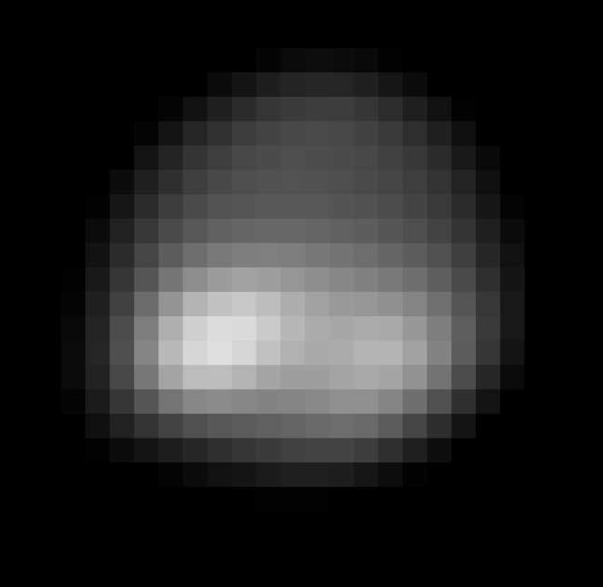
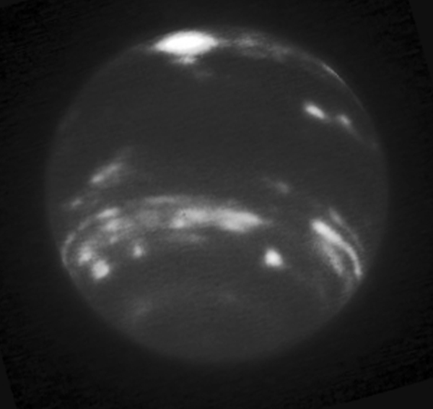
See new details and structure
Neptune, Keck, no AO
Neptune, Keck, AO
Structure is dramatically clearer
Must take care in measuring quantitative brightness of features
  AO PSF “spills” light from bright features into fainter areas
  PSF Reconstruction can help

Slide 7
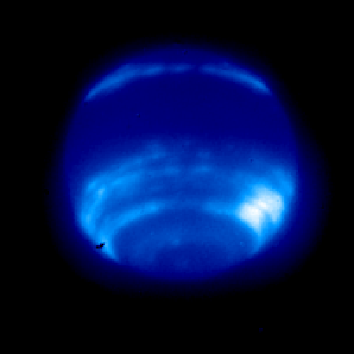
Spilling of light, Neptune bright clouds
Light from bright compact cloud region “spills” over limb, and into nearby dark areas
How do you tell what the “real” intensity is, in a dark region?

Slide 8
Will I detect fainter objects with AO? (1)
Assume a point source under sky-background-limited conditions. Total flux from object is F_{obj} (ergs/cm² or watts/m²).
Generally choose size of pixel such that two pixels sample a typical point-source diameter. So within the area of the PSF, n_{pix} ~4
The area of the PSF on the sky is ~ (2λ/D)² for AO, but is ~ (2λ/r₀)² without AO
So if all else is the same, the sky background B^{sky} within the PSF of a point source is (D/r₀)² larger for the no-AO case

Slide 9
Will I detect fainter objects with AO? (2)
Lick AO ( λ = 1.65 microns ):
  S = 0.4
  D = 3 m
  r₀ = 0.6 m
  T’_{ao} / T’_{noao} = 0.5
At 1.65 microns, the sky background per arc sec is the same with and without AO, so
Only for Strehl > 0.3 does AO give sensitivity advantage even for point sources

Slide 10
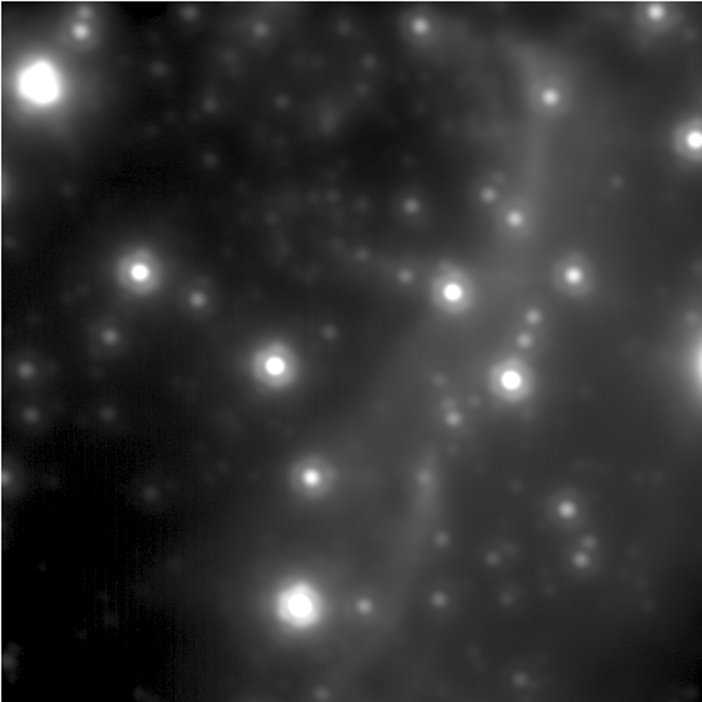
Galactic Center: NGS to LGS AO
Credit: Andrea Ghez’s group at UCLA
Best NGS

Slide 11
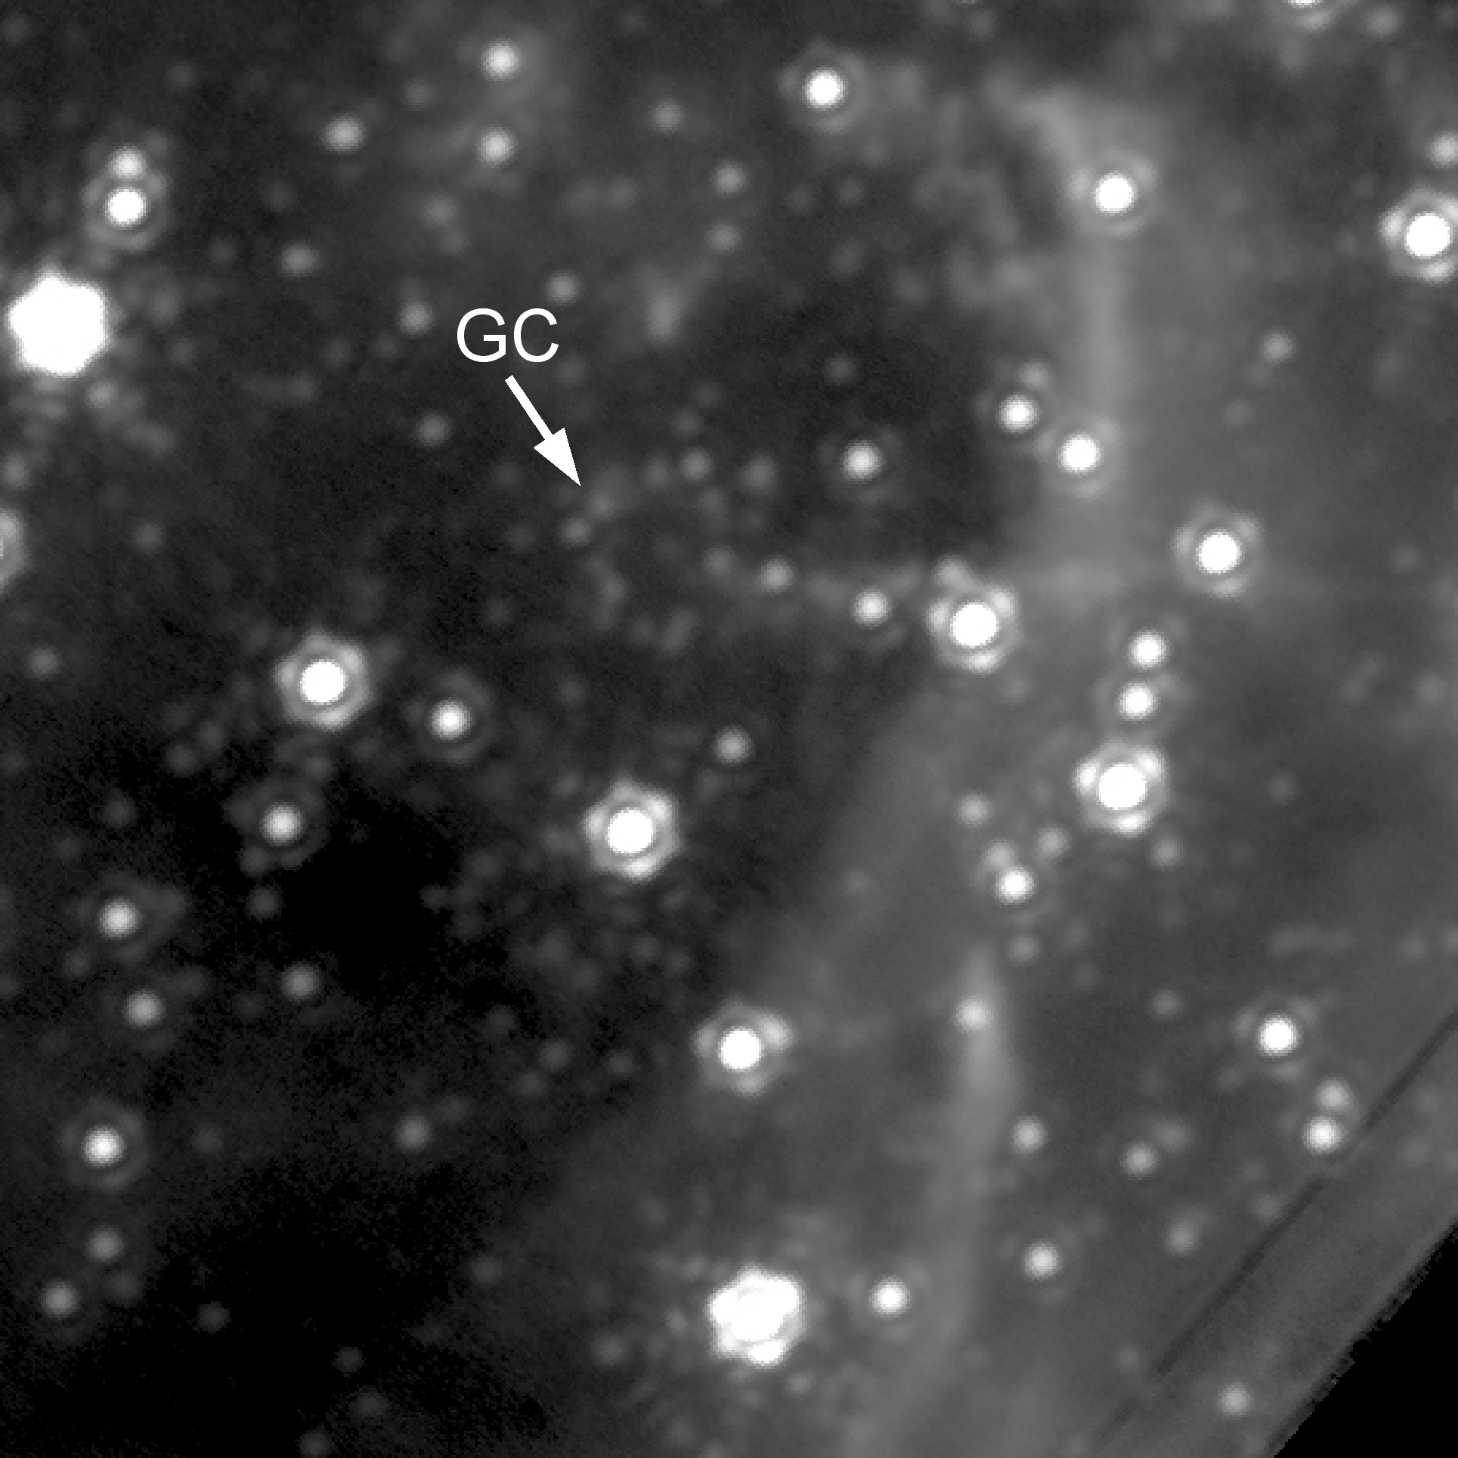
Galactic Center: NGS to LGS AO
Detect many more point sources (stars) with good LGS AO correction (higher Strehl)
LGS

Slide 12
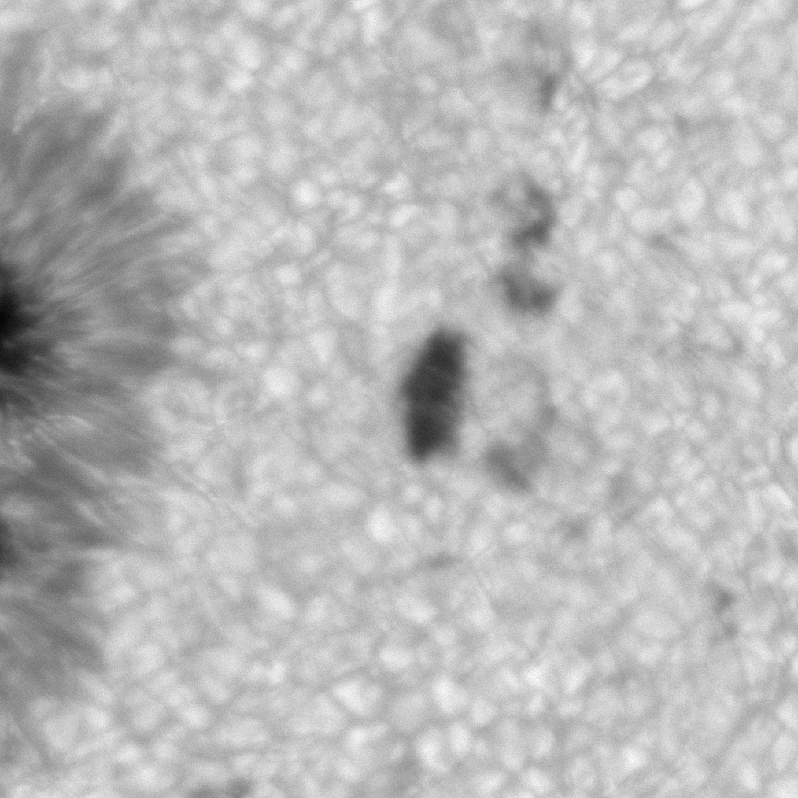
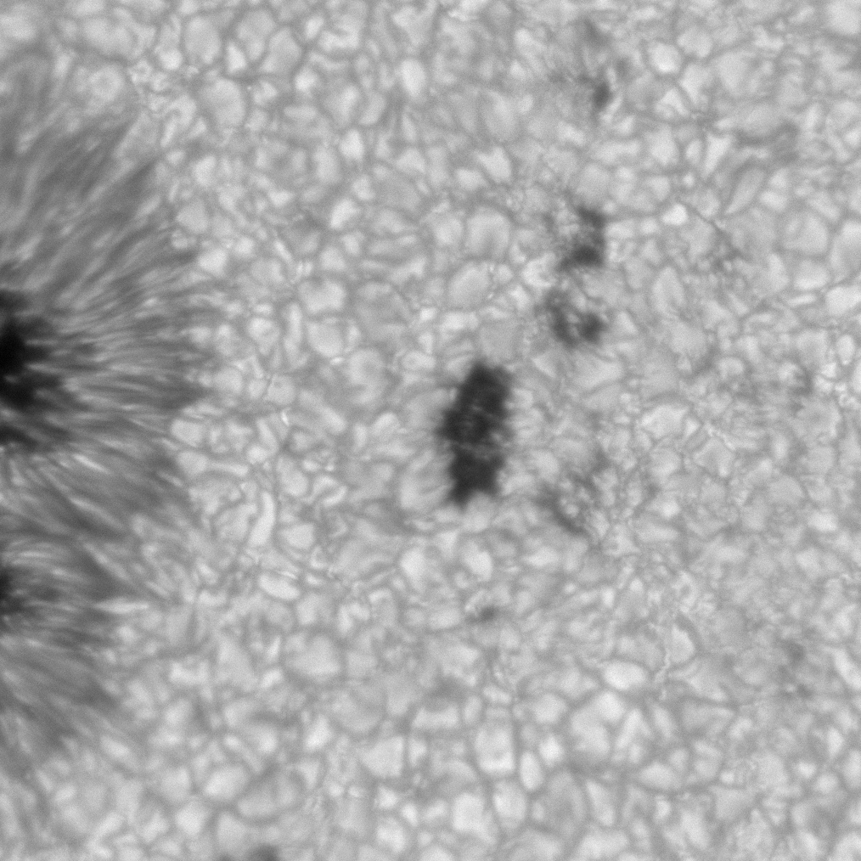
AO yields higher contrast, for small features
T. Rimmele
AO for imaging surface of Sun
Higher contrast on bright granules, dark regions in between where B field is emerging from sub-surface
AO off
AO off

Slide 13
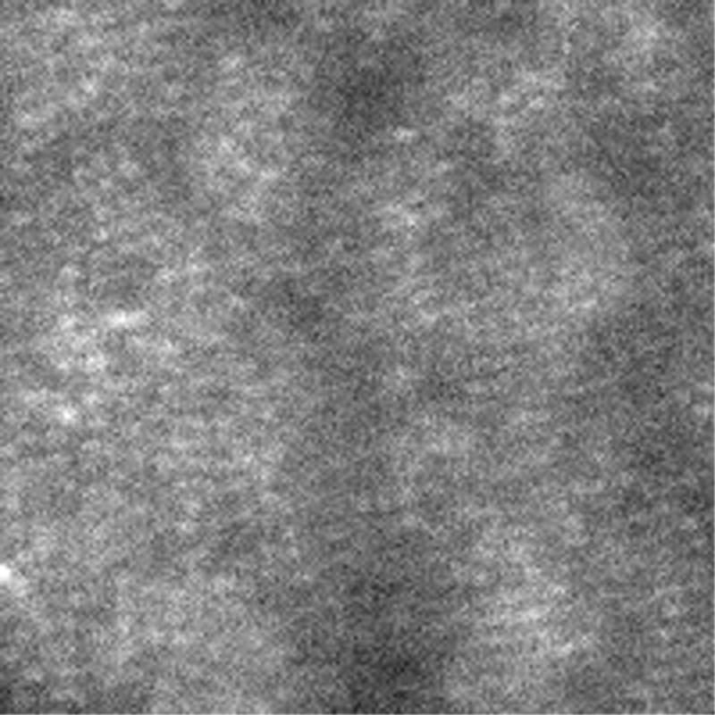
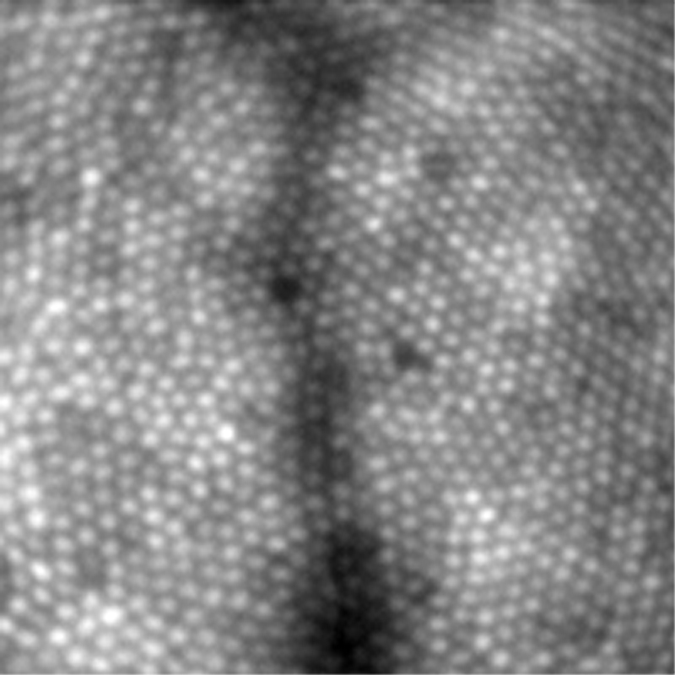
Example of higher contrast: vision science images of human retina
Austin Roorda and David Williams
Without AO
With AO: resolve individual cones

Slide 14
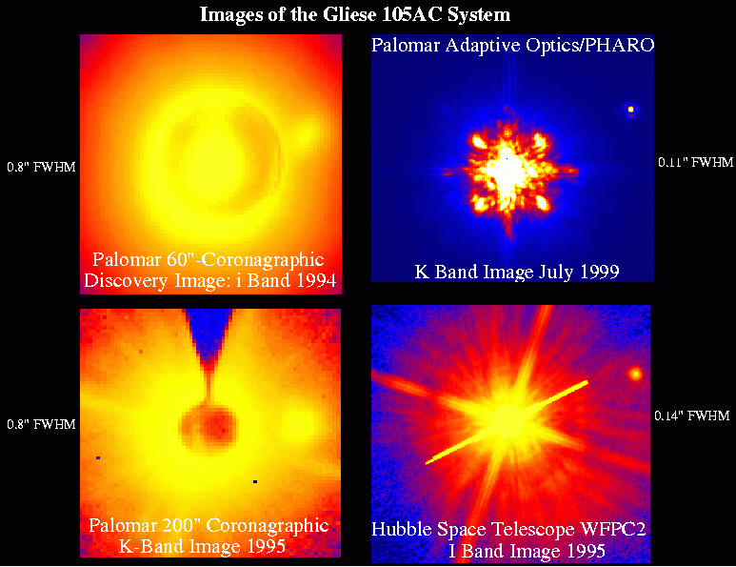
AO yields better contrast for faint objects next to bright objects
No AO
No AO

Slide 15
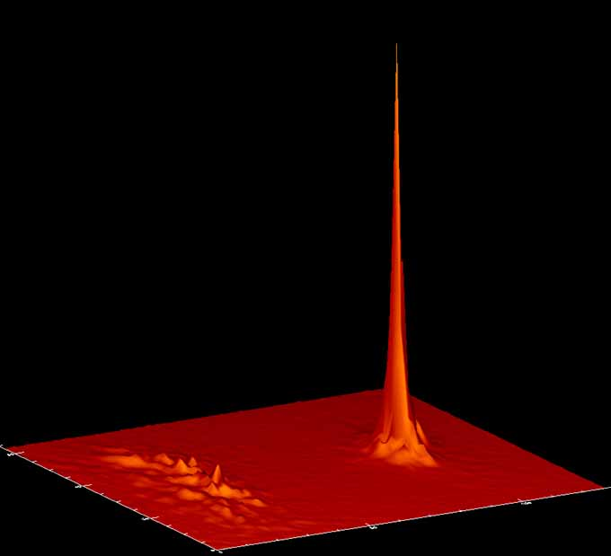
AO can permit more accurate astrometry (precise position measurement)
For a point source, accuracy of centroid measurement increases with intensity, decreases with image size
AO helps both of these
But: to do relative
astrometry, need stars
with known positions in
FOV. AO field is small.
Binary stars are
perfect for relative
astrometry
AO
No AO

Slide 16
Questions? Discussion?

Slide 17
How to plan observations ahead of time
First requirement: understand what Strehl ratio you will need for your science project to succeed
Estimate exposure time needed to achieve good SNR
  Some AO systems have exposure time calculators
  Or check with folks who have observed in the past
Refer to web pages to see what brightness guide star, at what distance, at what zenith angle, you will need
Check AO system web page for maximum offset between science target and guide star
Search star catalogues to find guide stars

Slide 18
Star catalogs for guide star search
(After B. MacIntosh)
Catalog
Mag Limit
Spectral info?
Notes
GAIA
G=21
Colors
Outstanding positions; excellent web interface
Hipparcos
9
Colors
Good accuracy, catalogue available as IDL file
Tycho 2
11-12
Colors
Accurate
HST Guide Star
15
None
Unreliable (but good near bright stars)
USNO B1.0
20
Colors
Incomplete near bright stars, funky close to big galaxies

Slide 19
Finding a guide star: Tools
VizieR http://vizier.u-strasbg.fr/viz-bin/VizieR
  Has the ability to do constrained searches – limited in position, magnitude, etc. – from a list of input targets
Aladin (one of Vizier’s capabilities)
  https://aladin.u-strasbg.fr/
  Can overplot a Digital Sky Survey image of your target with all the stars it can find from the catalogue of choice. Very useful for finding guide stars.

Slide 20
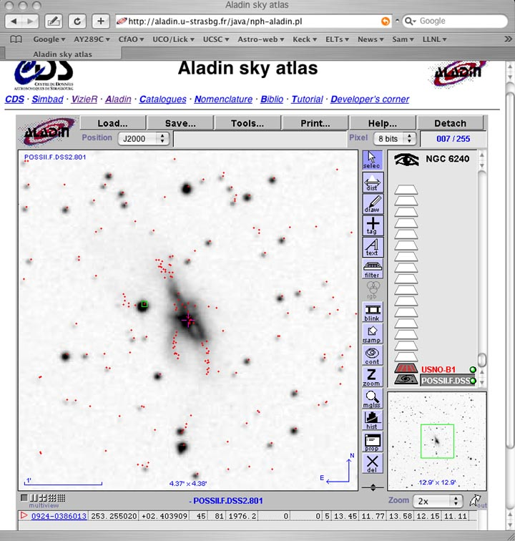
Aladin and USNO B1 catalog: virtues and pitfalls
Great user interface, many surveys
But gets confused near galaxies, nebulosity
Check out potential guide stars by eye!

Slide 21
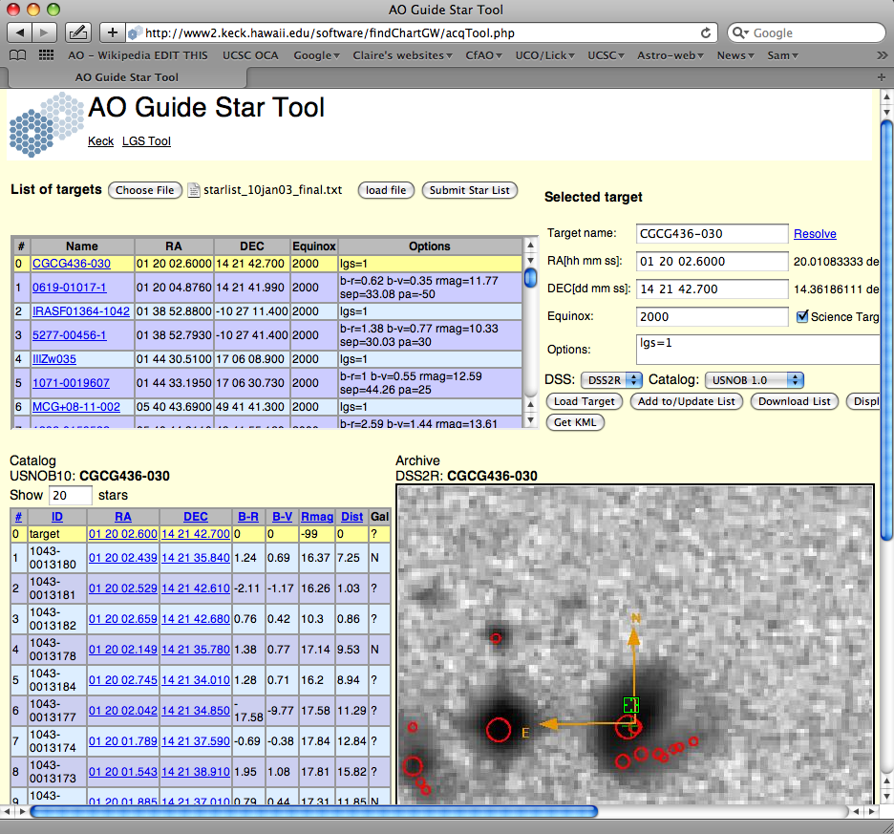
Some observatories have their own online guide star tools

Slide 22
Other questions to address prior to observing with AO system
PSF calibrations
  What is my PSF star calibration strategy?
  Can I do PSF reconstruction?
  What is the impact of anisoplanatism?
Observing time
  Calculate exposure times needed for good SNR
  Have I accurately estimated AO’s overhead (wasted time)?
Calibration and flat-fielding issues
  How will I calibrate the sky fluxes (offset skies, dithering, other?)
  How will I calibrate detector response variations?
  How will I calibrate photometry (brightness measurement)?
    Usually observe photometric standard stars
    How often? In what sequence?

Slide 23
“PSF stars”
Before, after, and sometimes intermingled with observing science target, observe “PSF star”
Constraints:
  If science target is offset in angle from guide star, can find PSF star pair with similar relative offset
  Should be at ~ same zenith angle as science target (but typically an hour or two earlier or later)
  PSF star should produce same number of wavefront sensor counts as guide star for your science target.
In practice it’s hard to meet all these conditions
With LGS, I typically end up using the tip-tilt star as PSF

Slide 24
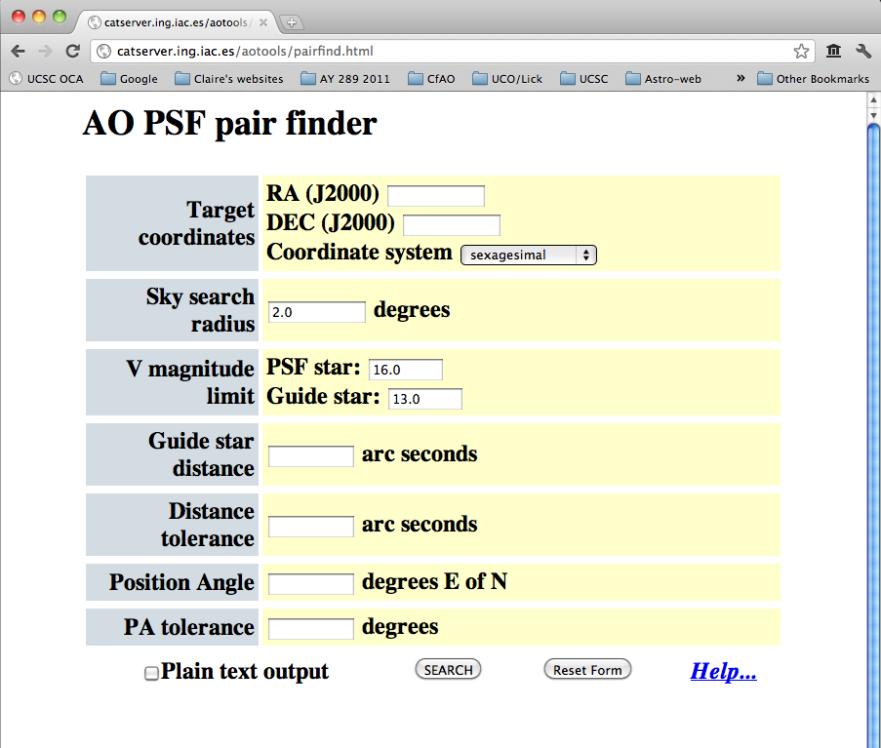
http://www.ster.kuleuven.be/~roy/ao/pairfind.html

Slide 25
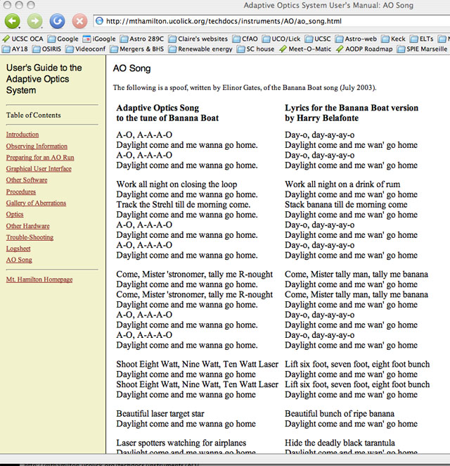
Sometimes you find creative endeavors on the web (!)

Slide 26
Laser guide star observing requires more preparation
US observatories have to submit target list to US Space Command (satellite avoidance) in advance
  Not good form to destroy the detector on a billion dollar satellite
Specific formats required
Check web pages for instructions

Slide 27
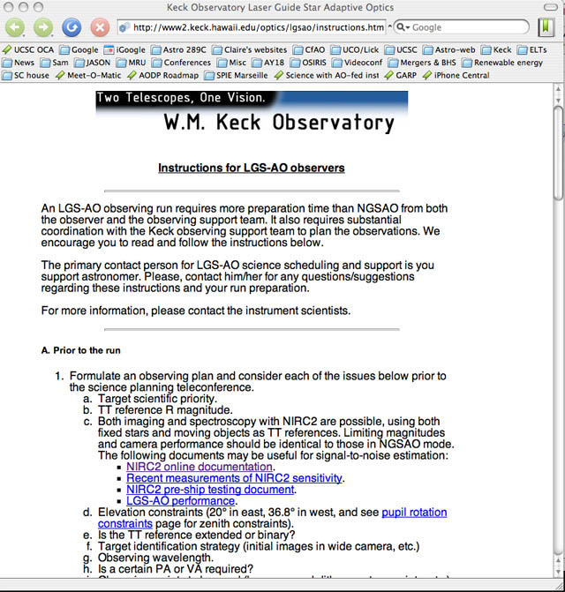

Slide 28
Questions to ask when you get to the telescope
If possible, come a day early and watch the previous night’s observers use the AO system
Ask for a “lesson” in how to control the AO system from the instrument interface
Typically the AO system is calibrated each afternoon
  Observatory staff will use an internal light source to measure non-common-path errors every day (before observing)
  Instructive to watch this process if you’ve never seen it before

Slide 29
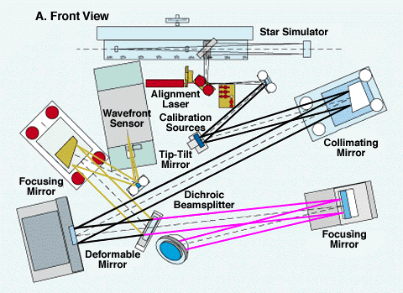
Why we must calibrate for non-common-path errors
To near-IR camera
Schematic of Lick AO system (one generation ago)

Slide 30
Overview of the calibration process (usually done by staff in afternoon)
Method varies from one AO system to another
Close dome, lights out, flatten the deformable mirror
Turn on internal light source (e.g. optical fiber with diode or laser light)
  Record centroid positions on wavefront sensor
  Record image of internal reference on camera
Adjust deformable mirror shape until image of internal reference has highest Strehl ratio
  Can do this one mode at a time (automated)
  Or Gertschberg-Saxton phase retrieval method
Record new positions of centroids on wavefront sensor. These will be the “reference centroids” to which AO loop will control.

Slide 31
AO tuning for your guide star
Wavefront sensor camera frame-rate and AO control loop gain optimized for your guide star
  For fainter guide stars, want slower frame rate
  With Shack-Hartmann WFS, typically need 100-200 counts per subaperture per wavefront sensor frame, for good performance
  For fainter stars, use lower control loop gain (lower bandwidth)
AO operator will take a sky background measurement for the wavefront sensor
  Subtracted from each wavefront sensor frame
Based on number of wavefront sensor counts, AO operator will run a program to optimize the AO system performance (trade frame rate against counts on wavefront sensor)
Then offset from PSF star’s guide star to the real guide star, turn on AO system, take images or spectra

Slide 32
Re-tuning the AO system during the night
When does operator re-tune AO system?
  At each new telescope pointing
  When background changes (clouds, moon)
  When flexure changes (after slew, long integrations)
  Whenever observer requests an updated tune-up
I usually keep an eye on the number of wavefront sensor counts per subaperture
  When it drops considerably below its original value, ask for a re-tuning

Slide 33
Other observing procedures are same as for any infra-red observations (1)
Take sky backgrounds
  Necessary in IR: science target can be dimmer than the sky background!
  Can nod to sky so that your science target is entirely off the detector, or
  If your science target is small enough, can get sky bkgnd just from dithering target on detector
Observe photometric standard stars several times during the night (if needed)

Slide 34
Other observing procedures are same as for any infra-red observations (2)
Dithering and nodding:
IR array non-uniformity requires sky measurement and subtraction
To obtain a sky subtraction, usually need a multiposition dither (1-2-3-4 etc.)
  If your science target is big, good to get a separate sky frame too
1
2
3
4
5 (sky)

Slide 35
Questions? Discussion?

Slide 36
How to assess the reality of AO results reported in the literature
Which data should you take seriously?
What are “danger signs” that should make you doubtful?

Slide 37
Taking data seriously: Three big issues
Strehl ratio and variability
Effect of using a non-point-source as a guide star or tip-tilt star
Signal to noise ratio

Slide 38
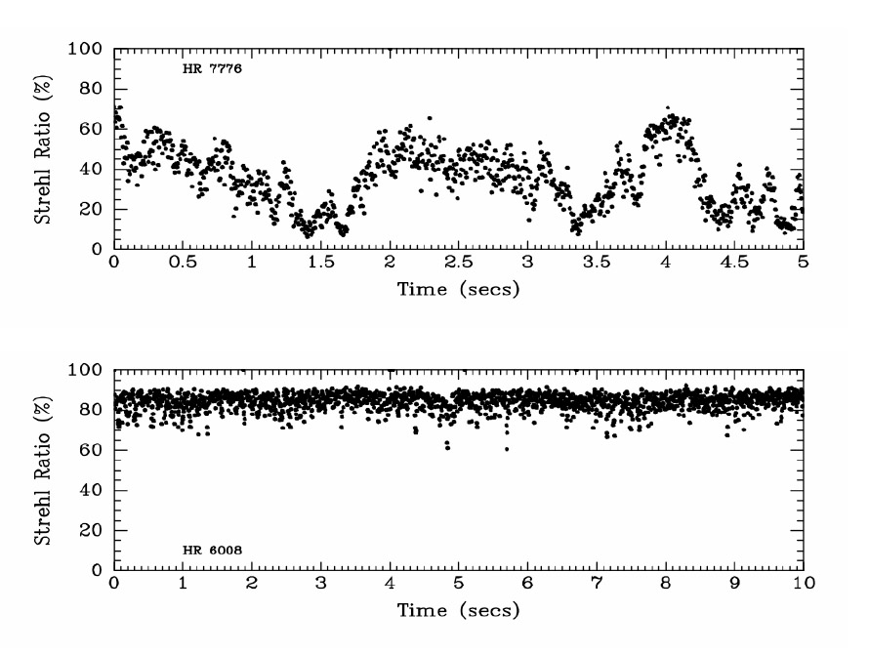
Taking data seriously: Three big issues
Higher Strehl ratios
are more stable
1) Strehl:
  Don’t trust low-Strehl results
  How low is low? My rule of thumb: “low” is S < 10%
  Problems: unstable photometry, variable PSFs
Credit: J. Christou et al.

Slide 39
Big issues, continued
2) Finite-size object used as “guide star”
  Frequently produces artifacts on point spread function
  Sometimes get “double-star” PSF
  Look for independent measurement of PSF if possible
  Also there can be issues with using finite-sized object as tip-tilt star
    Most important example: using bright nucleus of a galaxy as the tip-tilt reference
    The more point-like it is, the better
    No firm rules here about what to do – try it!

Slide 40
Big issues, continued
3) Signal to noise ratio of AO image or spectrum
  Rules of thumb (Hardy):
    SNR needed to recognize an object in a noisy background: SNR > 5
    SNR needed for spectroscopy is much larger: people use numbers like 20, 50, 100 per resolution element (depends on the application)
Be sure to look carefully at section of published paper where SNR is discussed.
  If it isn’t discussed, try to estimate it yourself.

Slide 41
“Journal of Irreproducible Results”
Danger signs:
Low Strehl ratios (e.g. 5% - 15%)
Use of an extended source as a “natural guide star”
  Can give PSFs that are double, or that have several lumps
Use of a “guide star” that IS a point source, but that is embedded in a fuzzy region
  Also can give odd PSFs
Look for repeatable independent measurements of PSF

Slide 42
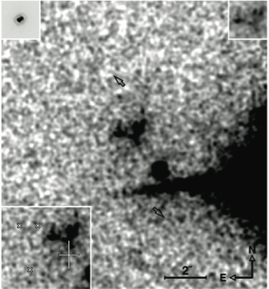
Radio galaxy 3C294 seen with early
UH AO system
Diffraction spike from guide star (a double star?)
Stockton et al.
UH AO System
CFHT Telescope

Slide 43
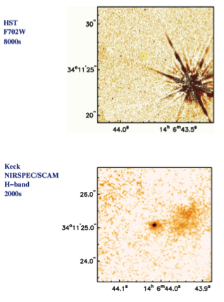
3C294 images from Hubble, Keck AO
Hubble (0.7 micron)
Keck AO (1.6 microns):
Bright point-like core, plus fuzz on right
From Wim de Vries. LLNL

Slide 44
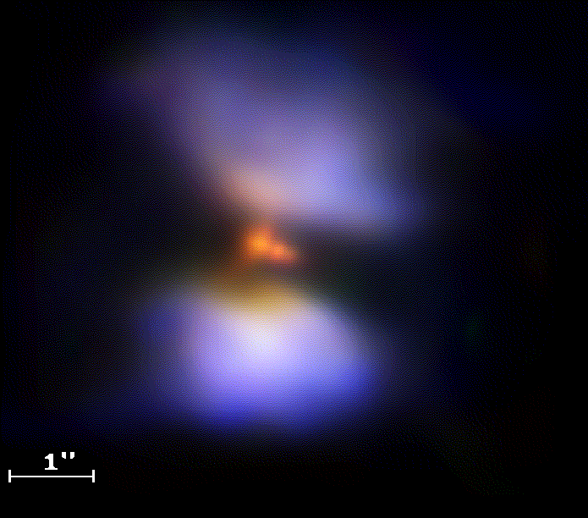
Example of dangers from extended guide star: Frosty Leo nebula
UH AO system
Closed AO loop on one of the big blue blobs
Concluded central star is double
Not confirmed by subsequent observations

Slide 45
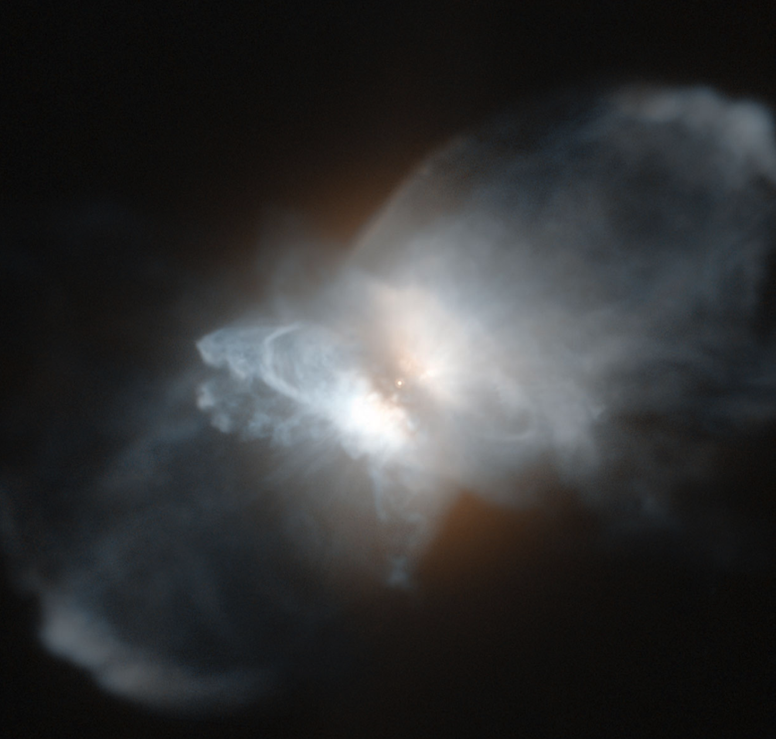
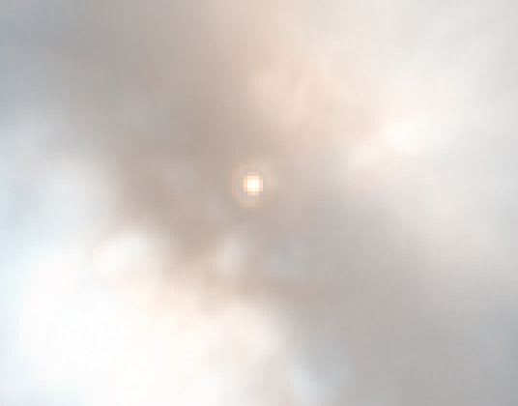
Hubble image of Frosty Leo
Visible light
Nice diffraction rings around a single star:

Slide 46
Conclusions
AO systems can yield flakey results if:
  Guide star is extended, or too faint
  Strehl is too low or too variable
Need good signal to noise (but that is no different from “regular” observations)
Need thoughtful preparation before an observing run
But…. RESULT CAN BE WORTH THE TROUBLE!

